Slide 1
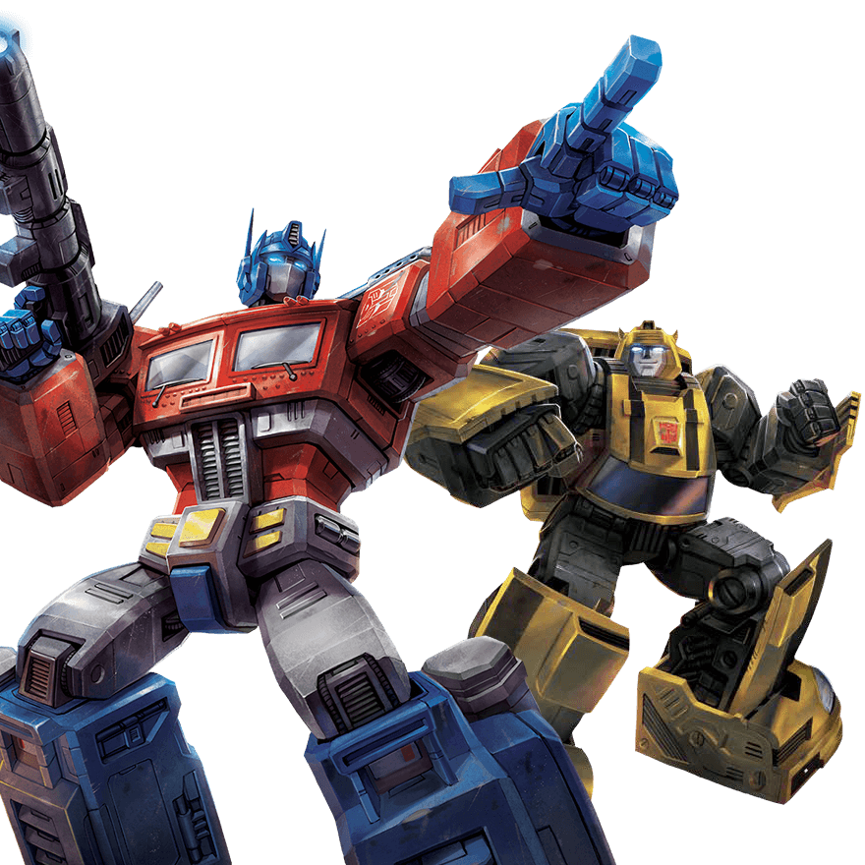

Transformer
BERT
李宏毅
Hung-yi Lee
Notes:
Sampling issue!
https://hackmd.io/RCUq11uHTmSw1UBRx-EB_g?fbclid=IwAR3pOrcUvAO4txW5-ThIunrT_FYs5rtgvZApmceu6Xszvi7uKpTUIwI1uIQ

Slide 2
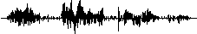
Sequence-to-sequence (Seq2seq)
Input a sequence, output a sequence
The output length is determined by model.
Speech
Recognition
你
好
嗎
N
T
機
器
學
習
Machine
Translation
machine
learning
N
N’
machine
learning
機
器
學
習
Speech
Translation
Language without text
Notes:
Speech Recognition + Machine Translation
Why don’t we simply concatenate two system?

Slide 3


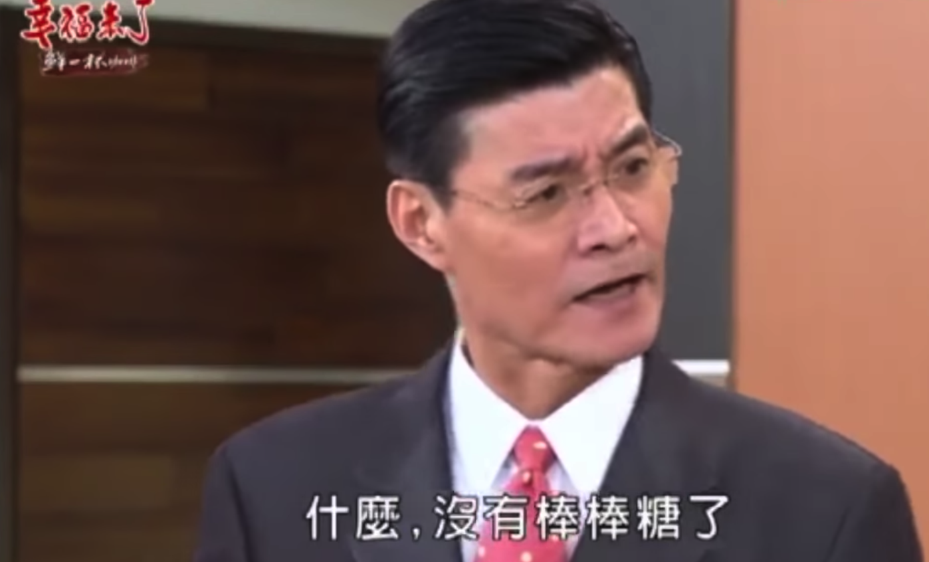
Hokkien (閩南語、台語)
Speech Recognition
“母湯”
??????? …
(Speech of Hokkien)
Speech
Translation
“不行”
(Speech of Hokkien)
Local soap operas (鄉土劇) on YouTube (Speech of Hokkien, Chinese subtitle)
Using 1500 hours of data for training

Slide 4
Hokkien (閩南語、台語)
Background music & noises?
Noisy transcriptions?
Phonemes of Hokkien?
Don’t care …
Don’t care …
No ……
“硬train一發”
(Ying Train Yi Fa)
Notes:
https://ieeexplore.ieee.org/document/8682801/ (ICASSP 2019)

Slide 5

Hokkien (閩南語、台語)
感謝 李仲翊 同學提供實驗結果
你 的 身 體 撐 不 住
沒 事 你 為 什 麼 要 請 假
要 生 了 嗎
Answer:不 會 膩 嗎
我 有 幫 廠 長 拜 託
Answer: 我 拜 託 廠 長 了
To learn more: https://sites.google.com/speech.ntut.edu.tw/fsw/home/challenge-2020
Notes:
https://ieeexplore.ieee.org/document/8682801/ (ICASSP 2019)

Slide 6
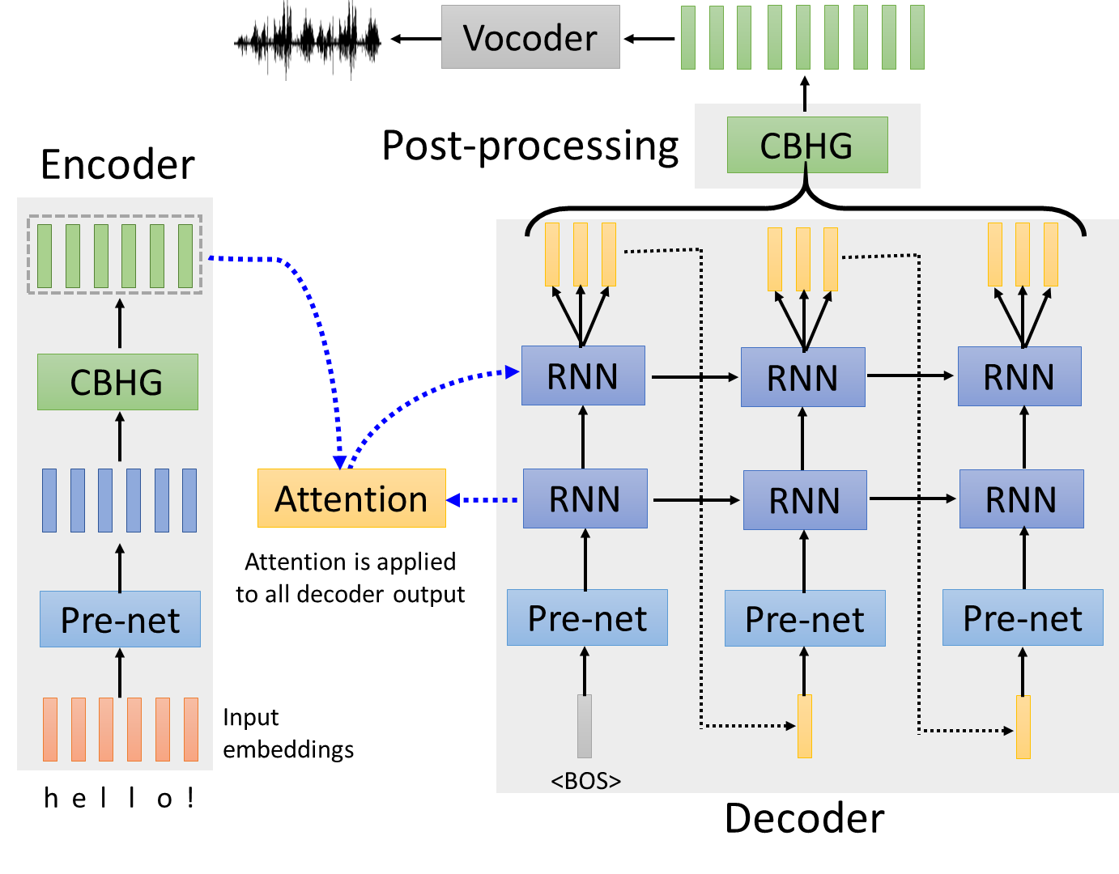
Text-to-Speech (TTS) Synthesis
感謝張凱為同學提供實驗結果
Taiwanese Speech Synthesis
Source of data: 台灣媠聲2.0
歡迎來到台大語音處理實驗室
最近肺炎真嚴重，要記得戴口罩、勤洗手，有病就要看醫生

Slide 7
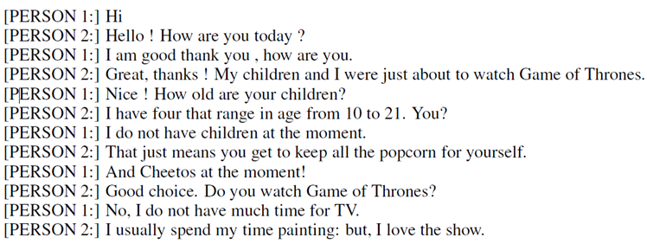
Seq2seq for Chatbot
“Hello! How are you today?”
seq2seq
input
response
“Hi”
Training
data:
Notes:
https://youtu.be/mk6v2raVGfk

Slide 8
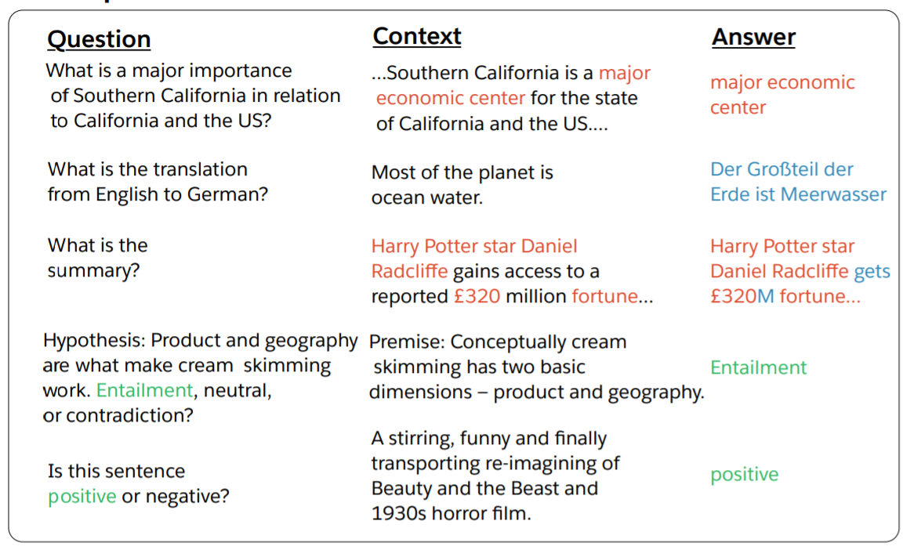
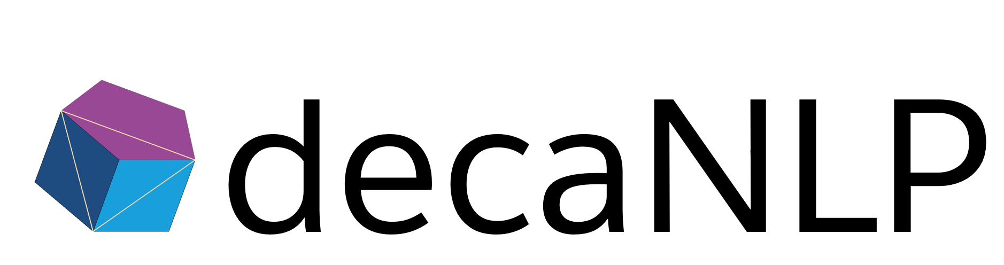
Most Natural Language Processing applications …
Question Answering (QA)
(sentiment analysis)
QA can be done by seq2seq
Seq2seq
question, context
answer
https://arxiv.org/abs/1806.08730
https://arxiv.org/abs/1909.03329

Slide 9
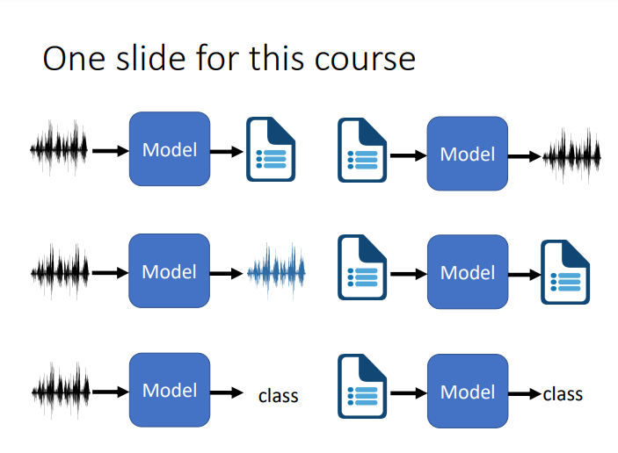
Deep Learning for Human Language Processing
深度學習與人類語言處理
Source webpage: https://speech.ee.ntu.edu.tw/~hylee/dlhlp/2020-spring.html

Slide 10
Seq2seq for Syntactic Parsing
Is it a sequence?
S
Model
Output
VP
NP
ADJV
Model
Input
deep learning is very powerful
Notes:
Oriol Vinyals
https://arxiv.org/abs/1412.7449
Of course, you can try other tree traversal approaches
state-of-the-art results …

Slide 11
Seq2seq for Syntactic Parsing
(S
(NP
deep
learning
)
(VP
is
(ADJV
very
powerful
)
)
)
Seq2seq!
S
VP
NP
ADJV
deep learning is very powerful
Notes:
Oriol Vinyals
https://arxiv.org/abs/1412.7449
Of course, you can try other tree traversal approaches
state-of-the-art results …

Slide 12
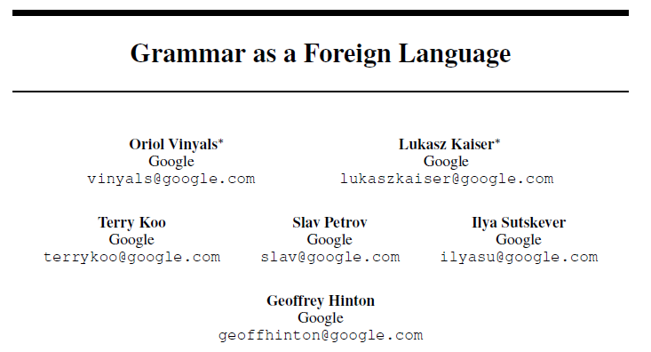
Seq2seq for Syntactic Parsing
(S
(NP
deep
learning
)
(VP
is
(ADJV
very
powerful
)
)
)
https://arxiv.org/abs/1412.7449
deep learning is very powerful
Notes:
Oriol Vinyals
https://arxiv.org/abs/1412.7449
Of course, you can try other tree traversal approaches
state-of-the-art results …

Slide 13

Seq2seq for Multi-label Classification
c.f. Multi-class Classification
An object can belong to multiple classes.
Class 1
Class 1
Class 3
Class 10
Class 3
Class 9
Class 17
Seq2seq
Class 9
Class 7
Class 13
https://arxiv.org/abs/1909.03434
https://arxiv.org/abs/1707.05495

Slide 14
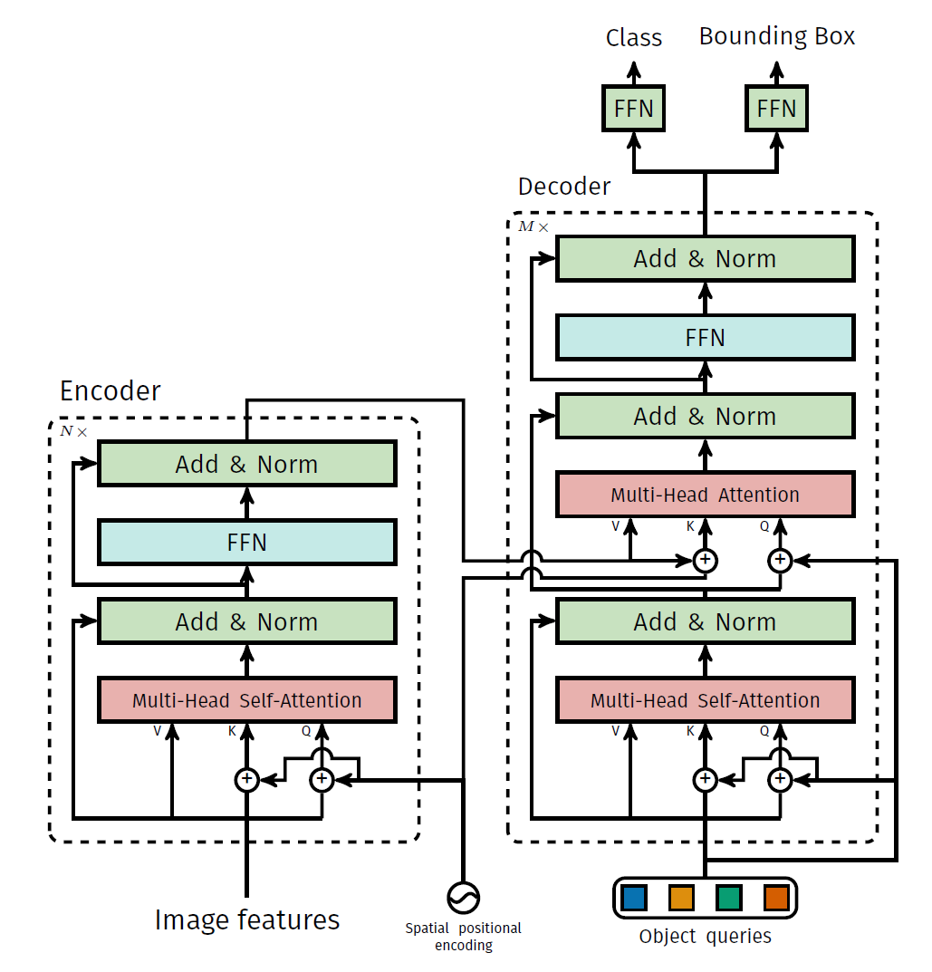
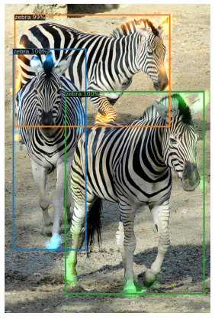
Seq2seq for Object Detection
https://arxiv.org/abs/2005.12872

Slide 15
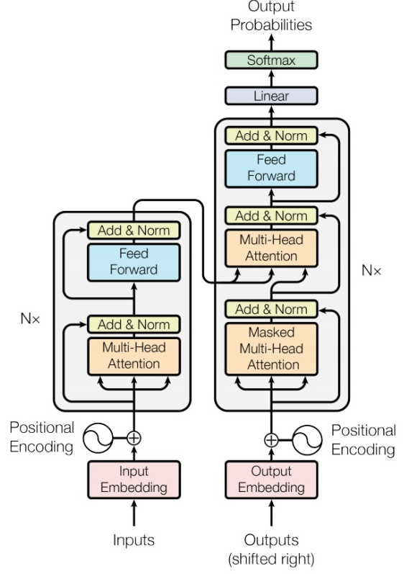

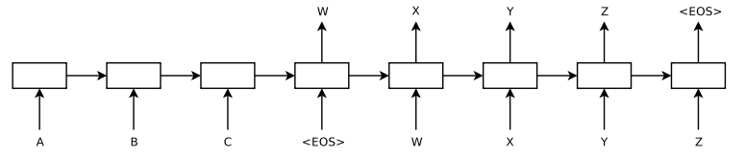
Seq2seq
output sequence
Encoder
Decoder
Input sequence
Sequence to Sequence Learning with Neural Networks
Transformer
https://arxiv.org/abs/1409.3215
https://arxiv.org/abs/1706.03762
Notes:
Sequence to Sequence Learning with Neural Networks
Ilya Sutskever, Oriol Vinyals, Quoc V. Le

Slide 16
Encoder
output sequence
Encoder
Decoder
Input sequence

Slide 17
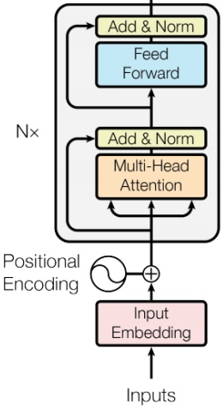
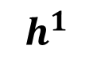
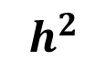
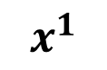
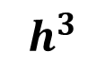
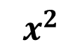
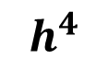
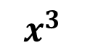
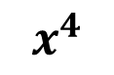
Encoder
Transformer’s Encoder
You can use RNN or CNN.
$$h^{1}$$
$$h^{2}$$
$$h^{3}$$
$$h^{4}$$
Encoder
$$x^{1}$$
$$x^{2}$$
$$x^{3}$$
$$x^{4}$$
Notes:
可以用 CNN, RNN
不用拘泥於 Transformer’s Encoder

Slide 18
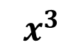
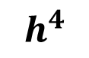
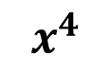
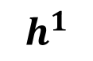
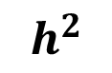
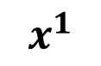
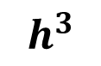
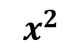
$$h^{1}$$
$$h^{2}$$
$$h^{3}$$
$$h^{4}$$
Block
…
…
…
…
FC
FC
FC
FC
Block
Block
Self-attention
$$x^{1}$$
$$x^{2}$$
$$x^{3}$$
$$x^{4}$$

Slide 19

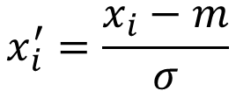
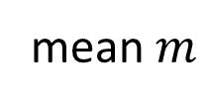
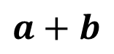
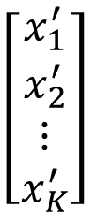
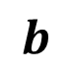
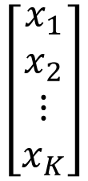
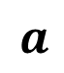
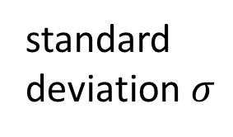
…
$$\left[\begin{aligned}x_{1}^{′} \\ x_{2}^{′} \\ ⋮ \\ x_{K}^{′}\end{aligned}\right]$$
$$x_{i}^{′}=\frac{x_{i}−m}{σ}$$
norm
Layer Norm
norm
norm
https://arxiv.org/abs/1607.06450
+
residual
$$a+b$$
$$\left[\begin{aligned}x_{1} \\ x_{2} \\ ⋮ \\ x_{K}\end{aligned}\right]$$
mean $m$
FC
standard deviation $σ$
$$b$$
+
$$a$$
Self-attention

Slide 20
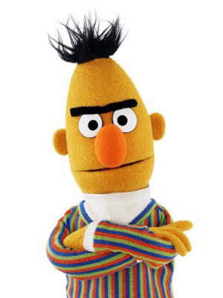
BERT
I use the same network architecture as transformer encoder.
$$h^{1}$$
$$h^{2}$$
$$h^{3}$$
$$h^{4}$$
Encoder
Residual
+ Layer norm
$$x^{1}$$
$$x^{2}$$
$$x^{3}$$
$$x^{4}$$

Slide 21
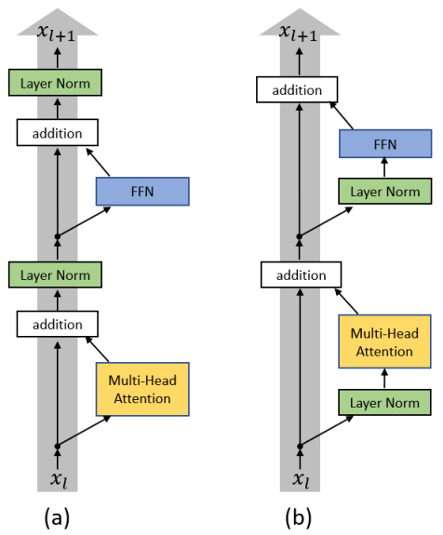
To learn more ……
On Layer Normalization in the Transformer Architecture
https://arxiv.org/abs/2002.04745
PowerNorm: Rethinking Batch Normalization in Transformers
https://arxiv.org/abs/2003.07845
Notes:
Why not BN?
https://arxiv.org/pdf/2003.07845.pdf
=======
This is about initialization
https://arxiv.org/pdf/1908.11365.pdf

Slide 22
Decoder
output sequence
Encoder
Decoder
Input sequence

Slide 23
Decoder – Autoregressive (AT)
output sequence
Encoder
Decoder
Input sequence

Slide 24
Autoregressive
distribution
(Speech Recognition as example)
學 | 0.0
機 | 0.8
器 | 0.0
習 | 0.1
…… | ……
機
Size V
max
(common characters)
softmax
Encoder
Decoder
( 機器學習 )
(special token)
START
Notes:
What is BOS?
Should I talk about sampling???

Slide 25
Autoregressive
機
器
學
習
max
max
max
max
Encoder
Decoder
( 機器學習 )
START
機
器
學
Notes:
What is BOS?

Slide 26
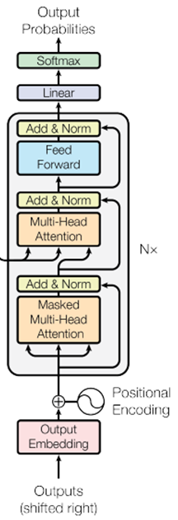
ignore the input from the encoder here ☺
機
器
學
習
max
max
max
max
Decoder
START
機
器
學
Notes:
What is BOS?

Slide 27
Encoder
Decoder

Slide 28
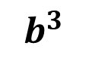
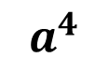
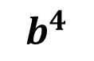
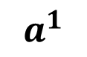
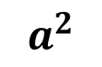
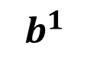
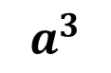
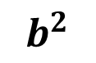
Self-attention
Masked Self-attention
$$b^{1}$$
$$b^{2}$$
$$b^{3}$$
$$b^{4}$$
$$a^{1}$$
$$a^{2}$$
$$a^{3}$$
$$a^{4}$$
Can be either input or a hidden layer
Notes:
Masked: attend on the generated sequence

Slide 29
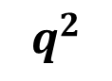
















Self-attention
Masked Self-attention
$$b^{2}$$
$$α_{2,1}^{′}$$
$$α_{2,2}^{′}$$
$$α_{2,3}^{′}$$
$$α_{2,4}^{′}$$
$$q^{1}$$
$$k^{1}$$
$$v^{1}$$
$$q^{2}$$
$$k^{2}$$
$$v^{2}$$
$$q^{3}$$
$$k^{3}$$
$$v^{3}$$
$$q^{4}$$
$$k^{4}$$
$$v^{4}$$
$$a^{1}$$
$$a^{2}$$
$$a^{3}$$
$$a^{4}$$
Consider how does decoder work
Why masked?
Notes:
Relation between attention and CNN
Global receptive field (compared to convolutional architectures)

Slide 30
Autoregressive
氣
機
器
學
習
max
Encoder
Decoder
Decoder
Output
( 機器學習 )
START
器
學
機
氣

Slide 31
Autoregressive
We do not know the correct output length.
Never stop!
機
器
學
習
慣
……
max
max
max
max
max
Encoder
Decoder
( 機器學習 )
START
機
器
學
習

Slide 32

推文接龍 (Tweet Solitaire)
推 tlkagk: =========斷==========
Notes:
接龍推文是ptt在推文中的一種趣味玩法，與推齊有些類似但又有所不同，是指在推文中接續上一樓的字句，而推出連續的意思。該類玩法確切起源已不可知(鄉民百科)

Slide 33
distribution
Adding “Stop Token”
學 | 0.0
機 | 0.8
器 | 0.0
習 | 0.1
…… | ……
END | 0.0
Size V
(common characters)
softmax
Encoder
Decoder
( 機器學習 )
START
Notes:
What is BOS?

Slide 34
Autoregressive
Stop at here!
機
器
學
習
END
max
max
max
max
max
Encoder
Decoder
( 機器學習 )
START
機
器
學
習

Slide 35
Decoder – Non-autoregressive (NAT)
output sequence
Encoder
Decoder
Input sequence

Slide 36

AT v.s. NAT
w₁
w₃
w₁
END
w₂
END
w₂
w₃
w₄
AT Decoder
NAT Decoder
START
w₁
w₂
w₃
START
START
START
START
How to decide the output length for NAT decoder?
Another predictor for output length
Output a very long sequence, ignore tokens after END
Advantage: parallel, more stable generation (e.g., TTS)
(why? Multi-modality)
NAT is usually worse than AT

Slide 37

To learn more ……
https://youtu.be/jvyKmU4OM3c
(in Mandarin)

Slide 38
Encoder-Decoder
output sequence
Encoder
Decoder
Input sequence

Slide 39

Transformer
Cross attention
Notes:
I need to know consider which layer?

Slide 40














FC
$$v$$
$$α_{1}^{′}$$
$$α_{2}^{′}$$
$$α_{3}^{′}$$
Cross attention
$$k^{1}$$
$$v^{1}$$
$$k^{2}$$
$$v^{2}$$
$$k^{3}$$
$$v^{3}$$
$$q$$
$$a^{1}$$
$$a^{2}$$
$$a^{3}$$
Encoder
Self-attention (Mask)
START

Slide 41


FC
$$v′$$
$$α_{1}^{′}$$
$$α_{2}^{′}$$
$$α_{3}^{′}$$
$$k^{1}$$
$$v^{1}$$
$$k^{2}$$
$$v^{2}$$
$$k^{3}$$
$$v^{3}$$
$$q′$$
$$a^{1}$$
$$a^{2}$$
$$a^{3}$$
Encoder
Self-attention (Mask)
START
機

Slide 42

Cross Attention
Listen, attend and spell: A neural network for large vocabulary conversational speech recognition
https://ieeexplore.ieee.org/document/7472621
(This is not transformer.)

Slide 43


Cross Attention
Source of image:
https://arxiv.org/abs/2005.08081
Notes:
https://arxiv.org/pdf/2005.08081.pdf?fbclid=IwAR3R4ezzOjQ0JN_dyH0RTbDJDuFKVgHdSPr30hCKAX58Q40OkAV72nlMSxE

Slide 44
Training
output sequence
Encoder
Decoder
Input sequence

Slide 45
學 | 0
機 | 1
器 | 0
鬼 | 0
…… | ……
Ground truth
distribution
機
學 | 0.1
機 | 0.7
器 | 0.1
鬼 | 0.1
…… | ……
Size V
minimize cross entropy
(common characters)
softmax
Encoder
Decoder
Label: 機 器 學 習
<BOS>
Notes:
What is BOS?

Slide 46
Teacher Forcing: using the ground truth as input.
機
器
學
習
<EOS>
minimize cross entropy
Encoder
Decoder
Ground Truth
Label: 機 器 學 習
<BOS>
機
器
學
習
Notes:
What is BOS?

Slide 47
Tips
output sequence
Encoder
Decoder
Input sequence

Slide 48
Copy Mechanism
Machine Translation
Chat-bot
User: X寶你好，我是庫洛洛
Machine:庫洛洛你好，很高興認識你

Slide 49

Copy Mechanism
https://arxiv.org/abs/1704.04368
Summarization

Slide 50

Copy Mechanism
Pointer Network
https://youtu.be/VdOyqNQ9aww
Incorporating Copying Mechanism in Sequence-to-Sequence Learning
https://arxiv.org/abs/1603.06393
Notes:
Jiatao Gu, Zhengdong Lu, Hang Li, Victor O.K. Li, “Incorporating Copying Mechanism in Sequence-to-Sequence Learning”, ACL, 2016
Caglar Gulcehre, Sungjin Ahn, Ramesh Nallapati, Bowen Zhou, Yoshua Bengio, “Pointing the Unknown Words”, ACL, 2016
https://arxiv.org/abs/1704.04368
Get to the point

Slide 51
Guided Attention
高雄發大財我現在要出征
發財發財發財發財
發財發財發財
發財發財
發財
(Missing an input character!)

Slide 52
























Guided Attention
Monotonic Attention
Location-aware attention
In some tasks, input and output are monotonically aligned. For example, speech recognition, TTS, etc.
Attention weights
$$a^{1}$$
$$a^{2}$$
$$a^{3}$$
$$a^{4}$$
$$a^{1}$$
$$a^{2}$$
$$a^{3}$$
$$a^{4}$$
$$a^{1}$$
$$a^{2}$$
$$a^{3}$$
$$a^{4}$$
generate the 1st output
generate the 2nd output
generate the 3rd output
$$a^{1}$$
$$a^{2}$$
$$a^{3}$$
$$a^{4}$$
$$a^{1}$$
$$a^{2}$$
$$a^{3}$$
$$a^{4}$$
$$a^{1}$$
$$a^{2}$$
$$a^{3}$$
$$a^{4}$$
generate the 1st output
generate the 2nd output
Generate the 3rd output
Something wrong!

Slide 53

Beam Search
The red path is Greedy Decoding.
The green path is the best one.
Not possible to check all the paths …
$→$ Beam Search
A
B
A
B
A
A
B
B
0.4
0.6
0.9
0.4
A
B
0.6
A
B
0.9
0.6
A
B
0.4
Assume there are only two tokens (V=2).
Notes:
不念博班
簽下去
Important for ASR

Slide 54

Sampling
The Curious Case of Neural Text Degeneration
https://arxiv.org/abs/1904.09751
Randomness is needed for decoder when generating sequence in some tasks.
Accept that nothing is perfect. True beauty lies in the cracks of imperfection. ☺
Notes:
寄生蟲的故事?

Slide 55
Optimizing Evaluation Metrics?
機
器
學
習
<EOS>
機
器
學
習
<EOS>
BLEU score?
Decoder
Decoder
How to do the optimization?
When you don’t know how to optimize, just use reinforcement learning (RL)!
https://arxiv.org/abs/1511.06732

Slide 56
There is a mismatch! ☹
exposure bias
機
器
學
機
氣
學
Decoder
Decoder
START
機
氣
<BOS>
器
機
氣
Ground Truth
Notes:
Exposure 曝光

Slide 57


Scheduled Sampling
Original Scheduled Sampling
Scheduled Sampling for Transformer
Parallel Scheduled Sampling
https://arxiv.org/abs/1506.03099
https://arxiv.org/abs/1906.07651
https://arxiv.org/abs/1906.04331

Slide 58
Schedule Sampling

Slide 59
Concluding Remarks:
Transformer
Notes:
I need to know consider which layer?

Slide 60


